Slide 1
Capstone 2
Mehmet Ozer

Slide 2
Statement of the Problem
Global warming’s dictionary definition is a gradual increase in the overall temperature of the earth's atmosphere and it is generally attributed to the greenhouse effect caused by increased levels of carbon dioxide, chlorofluorocarbons, and other pollutants. It has been a growing problem of whole humanity during the last couple decades.
The Paris agreement was signed by almost all United Nations countries by just a few exceptions. The major countries who did not sign the agreement were Turkey and Iran; however, just recently in 2020 the United States also opted out of the agreement because of the policies of the Republican Party and especially Donald Trump who was the president at the time. It did not last long for the United States to stay out of the agreement. They rejoined in 2021. The purpose of the Paris agreement is to take necessary precautions worldwide to keep temperature rise under control. One of the major reasons of global warming is the greenhouse effect caused by gas emissions. The agreement focuses on reducing the gas emission but it does not force any country to meet a specific emission target.

Slide 3
Purpose of the Study
The goal of this capstone project is to identify if the global warming phenomena is real and how much of change we are expecting to see during the next decades. Despite the discussions of if global warming exists this project focuses on also predicting the future climate for a chosen location in the world.
To find a meaningful location for this study I wanted to work with a location in the North Pole because I thought if there was any change it had to be more obvious in the poles. There were more than one location data available on the web; however, I chose Ilulissat because it was the only location which had the available data going back to 1824.

Slide 4
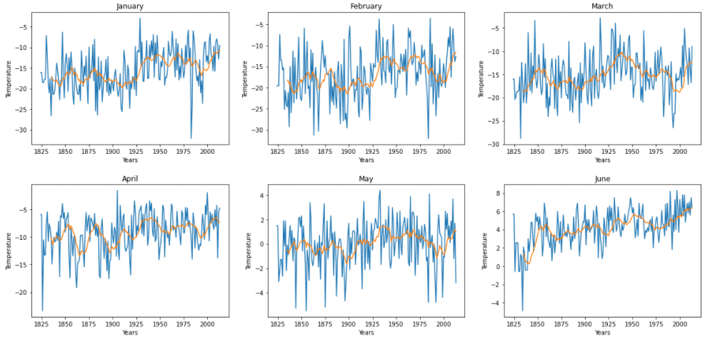
Exploratory Data Analysis
The plots below represent how the temperatures have changed over time by months. January-June

Slide 5
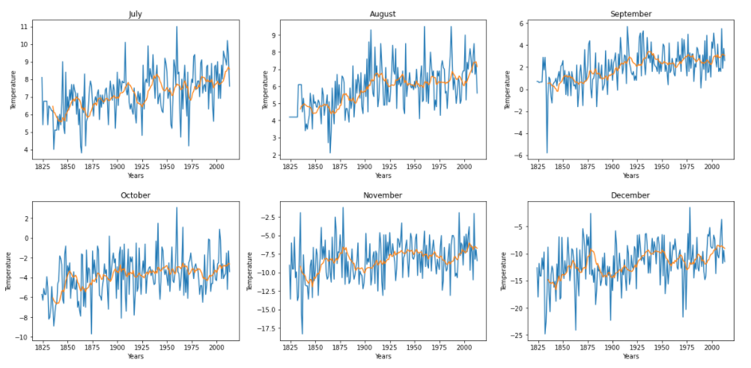
Exploratory Data Analysis
July - October

Slide 6
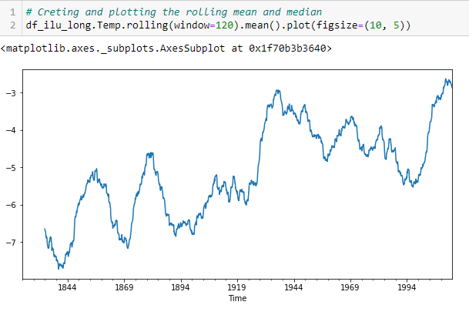
Rolling mean over the years

Slide 7
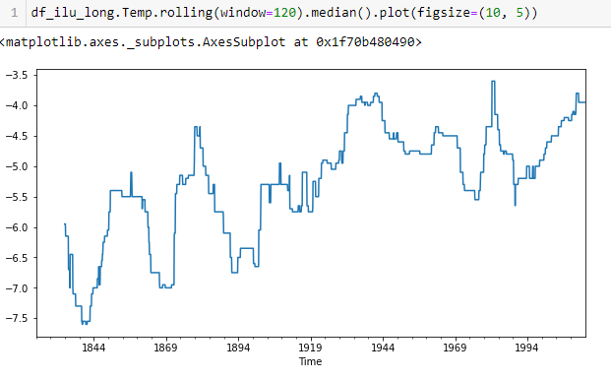
Rolling median over the years

Slide 8
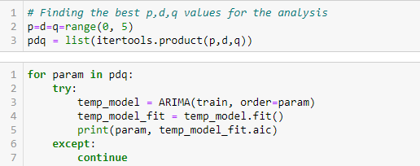
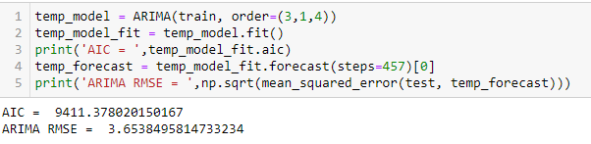
Modeling
ARIMA

Slide 9
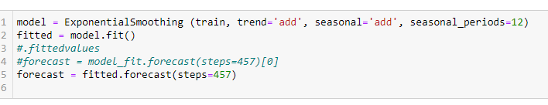

Modeling
Holt Winters

Slide 10
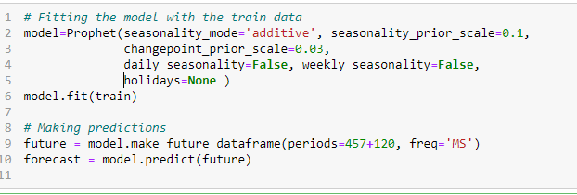
Modeling
Facebook Prophet

Slide 11
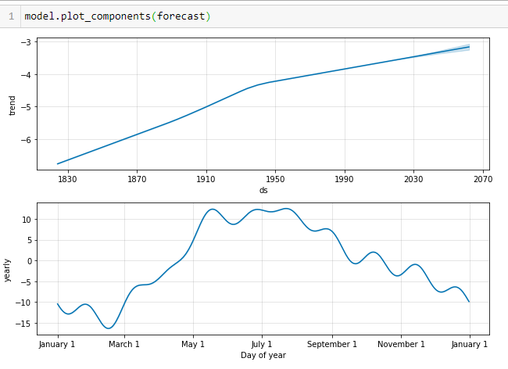
Conclusions
Predictions
As seen in the results of the models we can conclude that the best results were obtained by Facebook Prophet.
As seen on the graph and predicted value for Jan 2062 from the table the mean temperature of Ilulissat for January 1824 was -17.32 C and for January 2062 I am predicting with this model that it will be -13.5 C with RMSE score of 3.332. This is almost 4 degrees of increase. We can conclude by saying that global warming will be affecting the world in an enormous way during the upcoming decades.

Slide 12
Conclusion
This prediction system can be extremely useful for a variety of reasons for the whole world. The fertile land and conditions of growing crops is getting limited every year because of global warming. Many sea products are facing extinction right now or in the near future. Without a good solid prediction it will be real difficult for the world to be prepared for what is coming. We may see too many business fields going bankrupt if they do not prepare themselves for the changing world climate. This may be very real for those companies that rely on crops, sea food and animal husbandry. This study provides with information about what they may be expecting in the future and take precautions. Further studies may be conducted on the variables affecting the global warming. Also another study may be conducted on precipitation data and see which parts of world may face desertification faster than other locations and precautions may be harsher on these locations.

